Slide 1
ZOMATO LOCATION SCOUTING BY: Tejpal singh

Slide 2
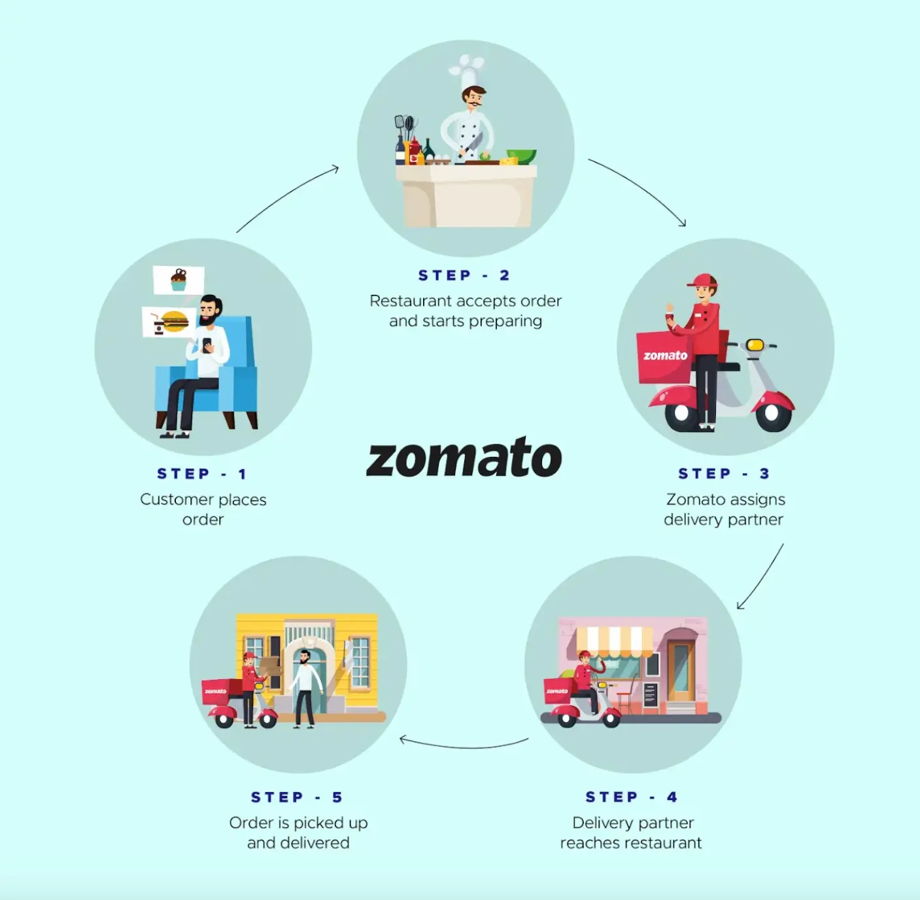
About zomato
Launched in 2010, Zomato is one of the most comprehensive and user-friendly apps for finding nearby restaurants and cafés to dine in or to order food online. It also gives menus, reviews, and ratings to acquire factual information on eateries.

Slide 3
AGENDA
01
02
03
04
05
Problem Statement
Data Description
Objective Key Metrics and Visualizations
Insights from Subjective Question
Strategic Recommendation and Dashboard

Slide 4
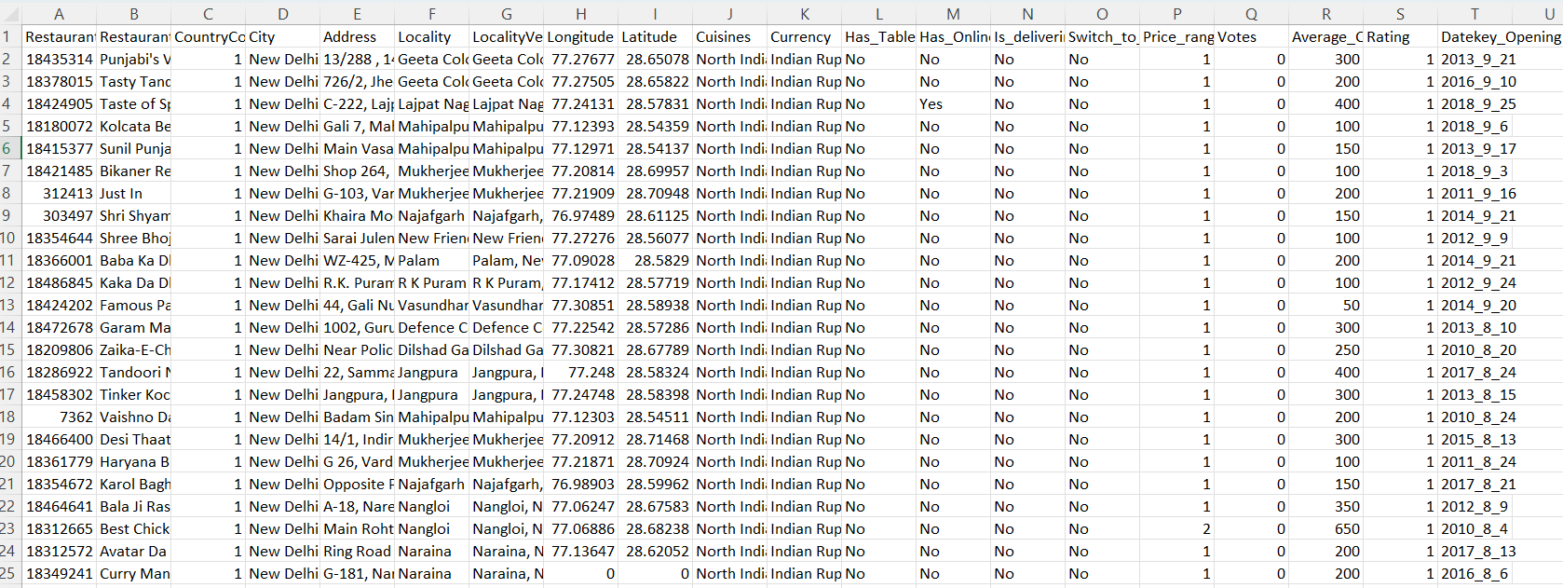
PROBLEM STATEMENT
You are hired as a consultant data analyst by Zomato where the team is looking for expansion and opening more restaurants. Your task is to develop strategies/suggestions for opening newer restaurants.

Slide 5
ZOMATO MARKETPLACE DATA
Restaurant ID: Unique identifier for each restaurant.
Restaurant Name: The name of the restaurant.
CountryCode: Country code of the location where the restaurant is situated.
City: The city where the restaurant is located.
Address: The specific address of the restaurant.
Locality: The locality or neighbourhood where the restaurant is situated.
Locality Verbose: Detailed information about the locality.
Longitude: The geographical longitude coordinate of the restaurant.
Latitude: The geographical latitude coordinate of the restaurant.
Cuisines: The type of cuisine offered by the restaurant.
Currency: The currency used for transactions in the restaurant.
Has_Table_booking: Indicates whether the restaurant has a table booking option (Yes/No).
Has_Online_delivery: Indicates whether the restaurant offers online delivery (Yes/No).
Is_delivering_now: Indicates whether the restaurant is currently delivering (Yes/No).
Switch_to_order_menu: Indicates whether users can switch to the order menu (Yes/No).
Price_range: A numeric value indicating the price range category of the restaurant.
Votes: The number of votes or ratings/(feedback) received by the restaurant.
Average_Cost_for_two: The average cost for two people dining at the restaurant.
Rating: The overall rating of the restaurant is based on user reviews.
Datekey_opening: The date when the restaurant was opened.
Country Code: The code assigned to a specific country that helps identify the country in raw data.
Country Name: The respective country for the given country code.
Countries_description: This sheet has all the country name alongside their international codes.

Slide 6
METHODOLOGY
Data Cleaning
Descriptive
Visualization
Competitor Analysis
Data Enrichment
Removed null and empty values which could hamper our analysis, such as in some places “cuisines” cell was empty.
Enhanced the dataset with additional variables like VLOOKUP to cross reference country.
Employed Pivot Tables for key metrics and identifying the competitor restaurants and top cuisines.
Identifying the competitors in the suggested areas.
Created dynamic charts and dashboard for data representation, enabling interactive data exploration

Slide 7
Number of restaurants Opened in each country
6) Number of restaurants Opened in each country
Column1 | Column2
India | 8643
Australia | 24
Brazil | 60
Canada | 4
Indonesia | 21
New Zealand | 40
Philippines | 22
Qatar | 20
Singapore | 20
South Africa | 60
Sri Lanka | 20
Turkey | 34
United Arab Emirates | 60
United Kingdom | 80
United States of America | 419
India seems to be the country with the highest number of restaurants, amounting to 8643 restaurants we have in our cleaned dataset. This comes to about 91% of restaurants in our dataset.
Followed by, USA and UK at 419 and 80 respectively.
Canada has the least number of restaurant after Qatar and Singapore with 4, 20 and 20 respectively.

Slide 8
Restaurants opened
We have a line chart for number of restaurants opened in the suggested countries by year.
We can see that new restaurant openings peeked in the year 2013 with 12 restaurants opened in a single year.
We can see after 2014 new restaurant opening took a huge plunge with just 4 new restaurants.
2015 was better with 10 new restaurants opened. 2016 saw decline in the trend.
After, 2016 we are seeing a steady growth in new restaurant opening and judging by the past trend it is expected to continue, we should focus on getting on this trend while its positive and open new restaurants

Slide 9
Average voters
Indonesia has the highest number of voters. Even after being a small country.
Brazil and Singapore lies in the lowest with only 20 & 32 average voters respectively.
We can see that even we have highest number of restaurants in India still the votes are pretty less.

Slide 10
Suggested countries
Row Labels | Count of RestaurantID | Average of Rating
Canada | 4 | 3.58
Singapore | 20 | 3.58
Sri Lanka | 20 | 3.87
Australia | 24 | 3.66
We can see that Canada, Singapore, Sri Lanka and Australia are countries with the least number of restaurants.
Also where the average rating of country in above average.
Less number of restaurants mean that the market is not saturated yet.
Less saturation means less competition.
Above average ratings mean that there is a scope for improvement.
Therefore, the suggestion is to focus on entering these countries.
We can further narrow our approach to focus on specific cities first.

Slide 11
Average ratings
To maximize success of new restaurants we can further study the average ratings in the target countries.
We can see that Sri Lanka has high rated restaurants with average rating of 3.87
Australia is not far behind with 3.66
Canada and Singapore has the same average rating of 3.58
By observing this we can conclude that we can have a edge over other restaurants if we work on good quality food, service and experience.
Even with high average food expenditure, they have restaurants with ordinary quality.

Slide 12
Cuisines
Cuisines are one of the most important factor when considering to open a restaurant.
In Australia Cuisines like seafood, pizza, Australian food are quite in demand.
In Canada Italian and Mediterranean foods are liked a lot.
In Singapore people are quite fond of Bakery and Italian.
In Sri Lanka Sea food, American, Fast food are mostly consumed.
We can use this information to have an idea about the cuisines that we should focus in in there respective countries.

Slide 13
Delivery and table booking
 | Online Delivery | Table Booking
Australia | 0 | 0
Canada | 0 | 0
Singapore | 0 | 0
Sri Lanka | 0 | 0
Online Delivery
26%
Total of 26% of restaurants offer online delivery.
Total of 12% of restaurants offer Table booking.
But as we can see that in our selected countries not even one restaurant offer online delivery or table booking
There is a great scope of improvement if we start online delivery and table booking features.
We can easily capture the market by doing this.
These facilities will be loved by people as it will make there life a bit easier.
Table booking

Slide 14
correlation
Correlation between rating and Average cost for two.
As the correlation is positive means that with increase in ratings the cost of food has also increased.
So if we give a good quality service and food we can also keep the price high.
CORRELATION 0.817623

Slide 15
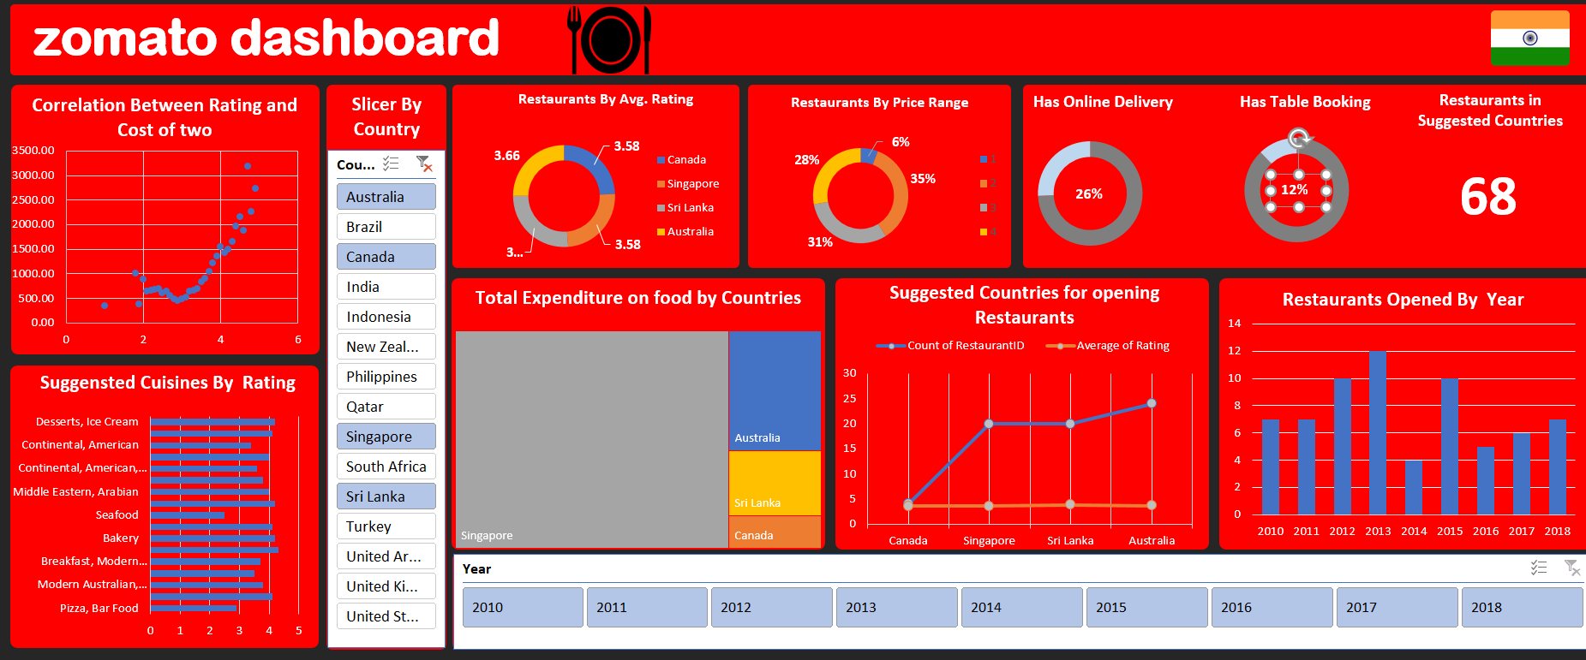

Slide 16


Conclusion
In conclusion, our analysis has pinpointed several key factors for successful restaurant expansion, focusing on countries with lower competition, cost-effectiveness, preference for online table booking, and careful selection of cuisines.
Focus on opening new restaurants in countries with untapped potential and favorable competitive landscapes.
Prioritize cities and states within these countries with lower restaurant density for optimal market entry.
I suggest Australia, Canada, Sri Lanka and Singapore for opening new restaurants.
By strategically selecting these countries, we can maximize our chances of success and minimize risks.

Slide 17
Thank you
By:
Tejpal Singh
tejpalsinghp96@gmail.com

